Slide 1
Achieving multisite setup in Drupal
By
Vimalnath Ravichandran (51324815)
&
Viswanath Gopalakrishnan (51324758)

Slide 2
Overview – Why Multisite with drupal?
This presentation is aimed to illustrate some of the famous multisite setup methodologies that Drupal has to offer.
But before stepping into the details lets pause a while to understand why it is preferred from a Customer perspective.
Imagine yourself being at the receiving end of the code, running multiple websites each meaning serious business.
Every website has a substantial amount of investment not merely in terms of money but a lot of time spent from ground work carried to gather requirements till the end of deployment.

Slide 3
Overview – Why Multisite with drupal?
When each site essentially runs off a different CMS or in some cases entirely different technology stack, there is a quite an investment in terms of resource both material and human.
Though each of the sites may be designed specifically with a CMS/technology stack suited for the site’s requirement, having to maintain and upgrade different sites would still prove more exhausting and the cost of having an expert resource for maintenance would prove cumbersome at some point.

Slide 4
Overview – Why Multisite with drupal?
Though this situation is frequent and unavoidable in many instances, there are situations when you have multiple sites running off the same CMS.
When this CMS happens to be Drupal where updating to a newer and more stable version of core happens to be a bit frequent, it helps to have multiple sites running from a single code base (core) and a single update saves time than updating multiple sites one at a time.
It so happens that there are many ways to bell the cat and we’ll look into some of the best methods that have been tried and tested.

Slide 5
Drupal Multisite - Overview
Multisite - This is the conventional method used in a multisite setup and comes as a part of out of the box drupal installation leaving us to deal with the necessary configuration changes.
This method is best applicable in the approach where there is a base domain with a few subdomains in a parent child hierarchy.
Subdomain, also called a child domain, a domain that is part of a larger domain name in DNS hierarchy.
For example, one.epicsubdomainex.com is the subdomain of epicsubdomainex.com.

Slide 6
Drupal Multisite - Overview
Advantages :
Cost effectiveness - It does not cost anything additional to setup a subdomain.
Ease of Update/Upgrade - Subdomains share a common core installation, which essentially reduces the burden of updating/upgrading several individual sites rather than a one time process for a single instance which reduces considerable overhead.
Mutually exclusive - The various subdomains may have their own modules and themes within their sub directories (sites/epicsubdomainex.com/<modules><themes> and sites/one.epicsubdomainex.com/<modules><themes>) in addition to the shared ones.

Slide 7

Drupal Multisite Adding DNS Entries
Edit your hosts file to ensure that these sites point within your local machine and does not search the internet. In a 32-bit windows XP/Vista/7 machine you would be able to find it in the path.
C:\Windows\System32\drivers\etc\hosts.

Slide 8
Drupal Multisite - Apache Settings
To Edit the Apache VirtualHost settings, you can locate the httpd.conf or httpd-vhosts.conf file depending on the operating system(if you are using XAMPP).
Windows:
XAMPP C:\Program Files\xampp\apache\conf\extra\httpd-vhosts.conf
WAMP C:\wamp\bin\apache\Apache2.2.11\conf\httpd.conf
Linux :
/etc/httpd/conf/httpd.conf
Below is a screenshot of where it is present in an XAMPP

Slide 9
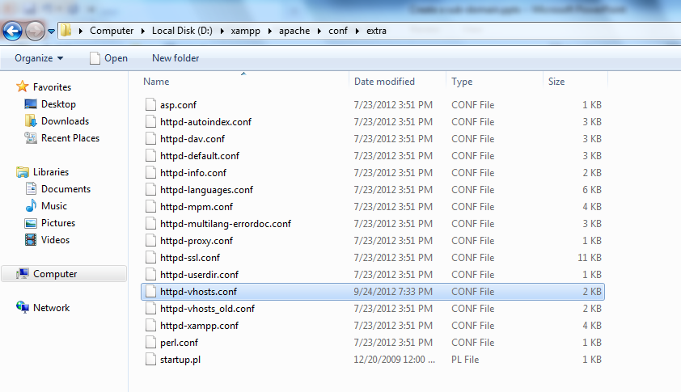
Drupal Multisite - Apache Settings

Slide 10
Drupal Multisite - Apache Settings
<VirtualHost 127.0.0.1>
#wildcard for subdomain name to handle all subdomain entries
ServerName *.epicsubdomainex.com
# Folder where the drupal installation exists
DocumentRoot "C:/wamp/www/epicsubdomainex/"
</VirtualHost>

Slide 11
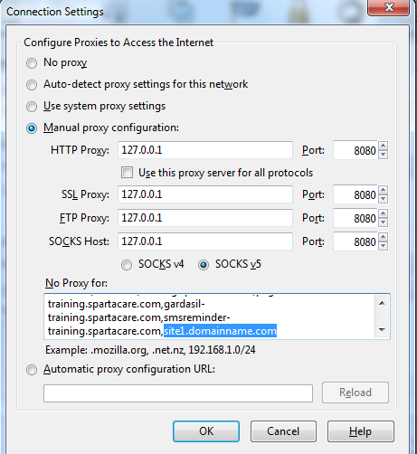
Checking Proxy settings
In case you also have a proxy setup on your browser make sure to exempt your newly added local domains from it.

Slide 12
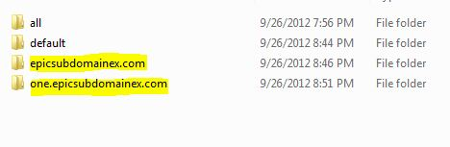
Drupal Multisite - Subdomain setup - A directory for a subdomain
Create a directory in the sites/ folder, for example:
epicsubdomainex.com
Copy the settings.php file from the default folder(sites/default) and paste inside the newly created folder(site1.domainname.com). Now sites/site1.domainname.com/ has its own settings.php

Slide 13
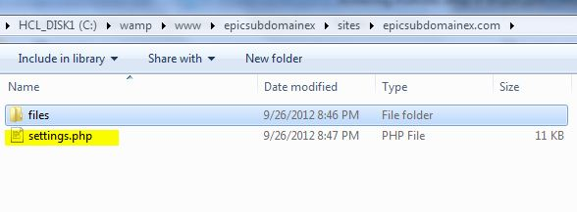
Drupal Multisite - Create a settings file
Note that the files directory is created as a part of the installation.
Open epicsubdomainex.com in the web browser and carry out a regular drupal install with its respective database credentials.
Once done it will make changes to the settings file and parent directory as read only (refer screenshot below)

Slide 14
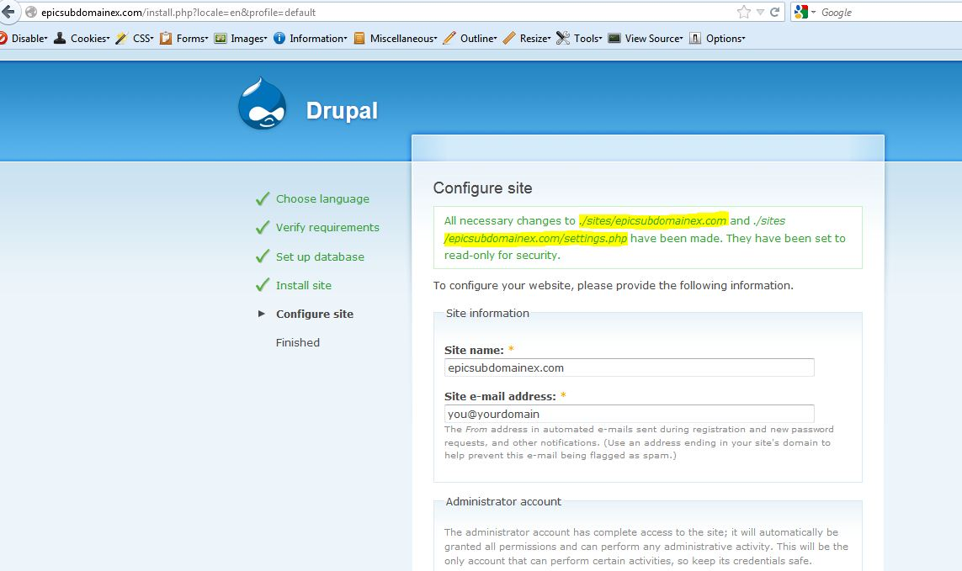
Drupal Multisite – Site installation

Slide 15
Drupal Multisite – Subdomain installation
Now the our epic site has been created we follow a similar method and create a directory (/sites/one.epicsubdomainex.com)with settings.php for our child site one.epicsubdomain.com.
When we open one.epicsubdomain.com in the browser it will directly lead to its installation page (Refer screenshot).
In case we did not have a separate directory for our new subdomain one.epicsubdomain.com and any similar subdomain path (xxxx.epicsubdomainex.com) would take us to epicsubdomain.com

Slide 16
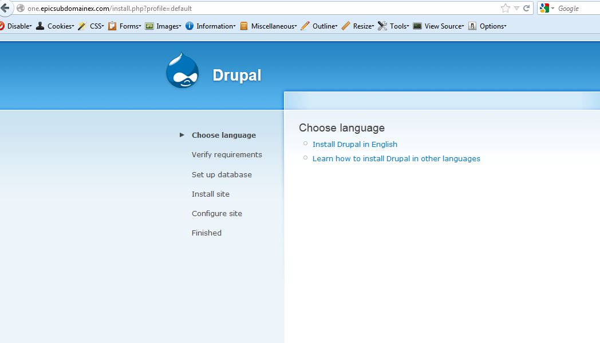
Multisite – Subdomain installation

Slide 17
Drupal Multisite
Note that though in the above example both our domain and subdomain have the same drupal core they have different databases from which they work.
This provides the independence of having modules enabled or disabled in each site as per needs
This also gives the liberty for both our base and subdomain to share modules and themes present in the sites/all/ directory but also have their isolated ones inside sites/<sitename> directory.

Slide 18
Drupal Multisite
Another aspect of multisite is to have a subdirectory structure in the form of epicsubdomainex.com/subdirectory whose settings file would look like sites/epicsubdomainex.com.subdirectory.
Some general guidelines about using drupal multisite are:
To use it when there is essentially a domain-subdomain hierarchy.
When the sites using multisite method are more or less identical in their functionality.

Slide 19
Domain Access
What it has to offer? Provides ease of installation of a domain with various ‘subdomains’ or other unrelated domains.
Advantage?
Again, free of cost and running of the same code essentially same server with minimal maintenance and update/upgrade overhead.
All the sites created using domain access share a common core installation, which essentially reduces the burden of updating/upgrading several individual sites rather than a one time process for a single instance which reduces considerable overhead.

Slide 20
Domain Access
Though made initially for sites essentially where there is a primary domain with a set of subdomains (ex. primary domain named myawesomedomain.com with subdomains sub1.myawesomedomain.com, sub2.myawesomedomain.com,sub3...etc.,) it can also be used for cases where the idea of domain-subdomain is non-existent and individual set of sites need to run of the same installation sharing some common data(i-e http://www.myawesomedomain.com and different site like http://www.myentirelyunrelatedsite.com can work with domain access) with a little DNS magic.

Slide 21
Domain Access
Prerequisite? The ability to edits hosts and set up DNS entries at will for the domains.
When it could be used? Essentially used when content needs to be 'shared' across various sites. Implies that all the sites can run off the same database without need for table prefixing unless it is necessary.
What makes it stand out of the rest?
Does not require any separate files/directories per each subdomain/domain unlike conventional multisite installation, making a dev/production setup much easier process (compare with multiple directories and settings.php in case of multisite installation).

Slide 22
Domain Access
Provides adequate out-of-the-box functionalities which cover most of the basic requirements.
Also comes with a well-documented API guide for extensibility of functionalities for developing customized requirements and some contributed modules that serve as added advantage with having domain access.

Slide 23
Domain Access Setup
Installing Domain Access Module
The domain access module installation is pretty easy and straight forward, it follows almost the same installation methodology of a normal drupal module save for some tiny details provided in its installation documentation.
The settings.php (sites/default) file has to be suitably edited to include the domain settings.inc at the end, so that the domain functionalities are bootstrapped.

Slide 24
Domain Access Setup
Note: Ensure that the path to the domain module is provided appropriately as in many cases contributed modules are installed in a subdirectory named 'contrib' to prevent a fatal error.
Once the change in the settings.php is effected we could install the module in the usual drupal way navigating to Administer >> Site Building >> Modules and enable the Domain and related sub modules which we require.

Slide 25
Domain Access Setup
After the necessary modules are created a new menu is made available under Administer >> Site Building >> Domain.
Based on the modules installed in the domain package the number of tabs in the Domains page may vary, but primarily our concern with the installation will be the Domain List tab and the Create Domain Record tab.

Slide 26
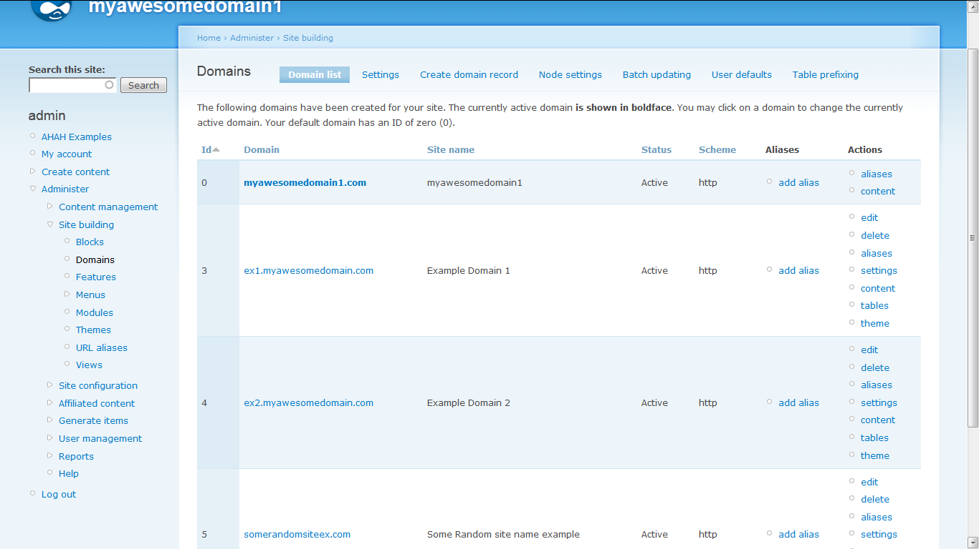
Domain Access Setup – Domain List

Slide 27
Domain Access Setup
In the Create domain tab user can create a new domain by adding its domain name, user referenced name, the protocol it uses and its state if it is Enabled or Disabled.

Slide 28
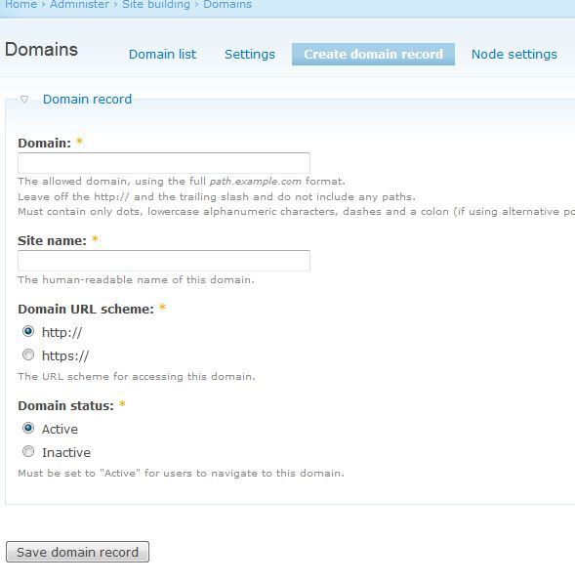
Domain Access Setup – Creating a domain record

Slide 29
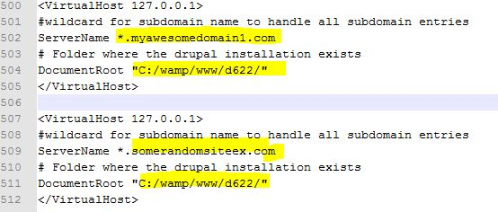
Domain Access Setup – Apache host editing
Ensure to add the vhost entries for our domains, for in depth info refer the data from apache host info from multisite.
The first host entry satisfies both the base and any subdomain of myawesomedomain1.com and the second entry is for an unrelated (not a subdomain) domain named somerandonmex.com

Slide 30

Domain Access Setup – Local DNS Entry & Proxy
Enter local DNS entries in a manner described earlier for our new sites.
Make sure to add the proxy information for our domains in case a proxy is used.

Slide 31
Domain Access Setup
Once the local environment changes are done and new domains are added in the domain access panel we are good to go.
Note: The URL rewriting (custom_url_rewrite_outbound()) is carried out by domain access' built-in method and any user added method for the same must be checked to prevent conflict of functionality with the domain access' version.

Slide 32
Domain Access Setup
Another point to note is that if domains mydomain1.com and its subdomain xx.mydomain1.com requires signing in one domain to be authenticated in all we could have the $cookie_domain value in settings.php enabled and set as .mydomain1.com.
When we have an unrelated domain which might have its own subdomain it might require to create a /sites/unrelateddomain.com/settings.php with the appropriate value for its $cookie_domain for a single authentication across sites.

Slide 33
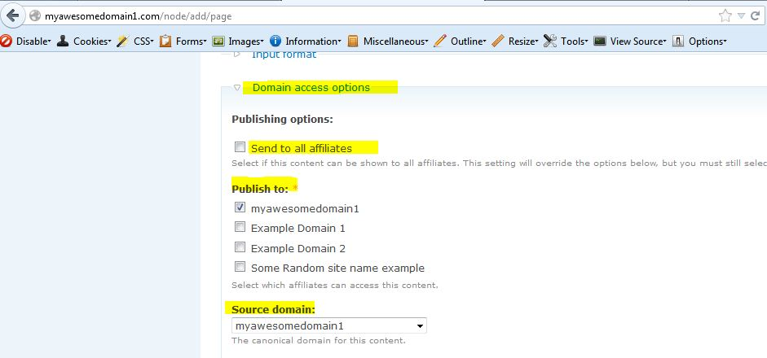
Domain Access – Content Sharing (Node Addition Page)

Slide 34
Additional functionalities using domain access and its contributed modules
Aside from the ability to create domains out of a single installation without any directory structure change domain access provides a whole set of goodies tailor made for many common requirements with contributed modules packaged along with it and some related modules that enhance its functionalities.
Domain Prefix module bundled along with the domain access package enables users to prefix specific tables for suiting their requirements.

Slide 35
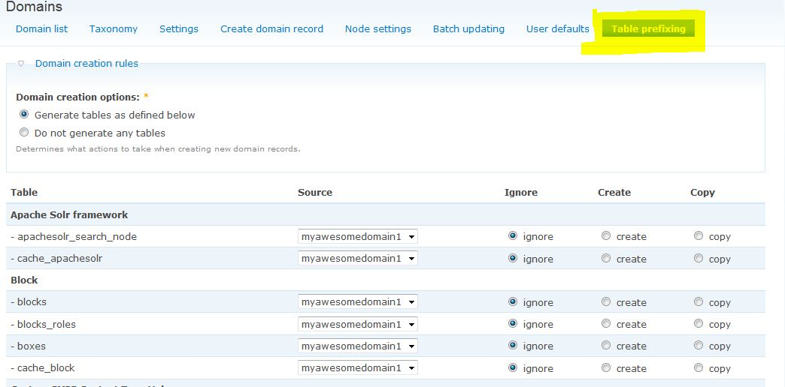
Additional functionalities – Table Prefixing

Slide 36
Additional functionalities – Domain Prefixing
An example where domain prefixing would be of use is in case when two domains run off the same theme but have their blocks in different regions, prefixing the block, boxes and related tables thus each domain has its own version of block settings making them independent of each other.

Slide 37
Additional functionalities – Domain Prefixing
Besides Domain prefixing the domain access module also provides couple of other modules namely Domain Strict and Domain user.
The Domain strict enforces rule on user, that the user be associated with a domain (or subdomain) to be able to access its content.
Domain User module enables user to create a domain with their username serving as the prefix.

Slide 38
Additional modules – Domain Taxonomy
Another significant module is the Domain taxonomy which enables every vocabulary, and its terms to be associated with one or more domain.

Slide 39
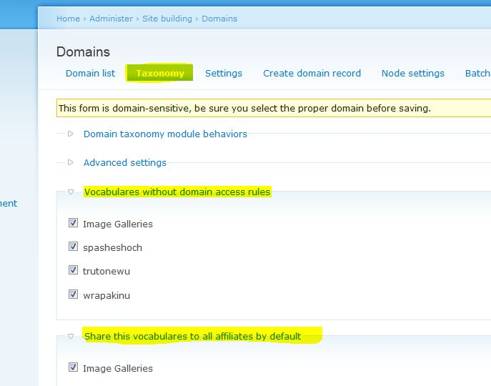
Additional functionalities – Domain Taxonomy

Slide 40
References
Drupal multisite setup: http://drupal.org/documentation/install/multi-site.
Drupal domain module home: http://drupal.org/project/domain.
Drupal domain module Documentation: http://drupal.org/documentation/modules/domain
Drupal domain taxonomy: http://drupal.org/project/domain_taxonomy

Slide 41
Thank you!
Please feel free to communicate/report your opinions/feedbacks/comments/errata to
vimalnath.r@hcl.com & viswanath.g@hcl.com and provide your valuable suggestions.

